Slide 1


Hazard-based Classification System for Lithium Batteries
Ting Xu, Hong-Hui Wang
2026.07
Shanghai Institute of Chemical Industry Testing Co. Ltd.

Slide 2
1. Classification Scheme
Great progress on the classification system under IWG and everyone’s efforts, but some issues still exist.
6 tests
Test T.9: Cell propagation test
Test T.10: Cell gas volume determination
Test T.11: Battery propagation test
Test T.12: Battery gas volume determination
Test T.13: Cell gas flammability determination
Test T.14: Air gap determination
5 tests
Test T.9: Cell propagation test
Test T.10: Cell gas volume determination
Test T.11a/b: Battery propagation test
Test T.12: Battery gas volume determination
Test T.13: Cell, battery or equipment thermal runaway propagation prevention (equivalent air gap determination)
Hazard factors
Thermal runaway & thermal propagation；
Gas flammability；
Gas volume: 0.25, 25, 500L；
High temperature: ΔT>150℃；
Hazard factors
Thermal runaway & thermal propagation；
Gas volume: 0.25, 25L；
High temperature: ΔT>150℃；
Experts from Belgium, France, RECHARGE on behalf of the IWG. Hazard-based system for classification of lithium batteries. UN/SCETDG/66/INF.32.
Experts from Belgium, France, RECHARGE on behalf of the IWG. Hazard-based system for classification of lithium batteries. UN/SCETDG/68/34&INF.13-15.

Slide 3
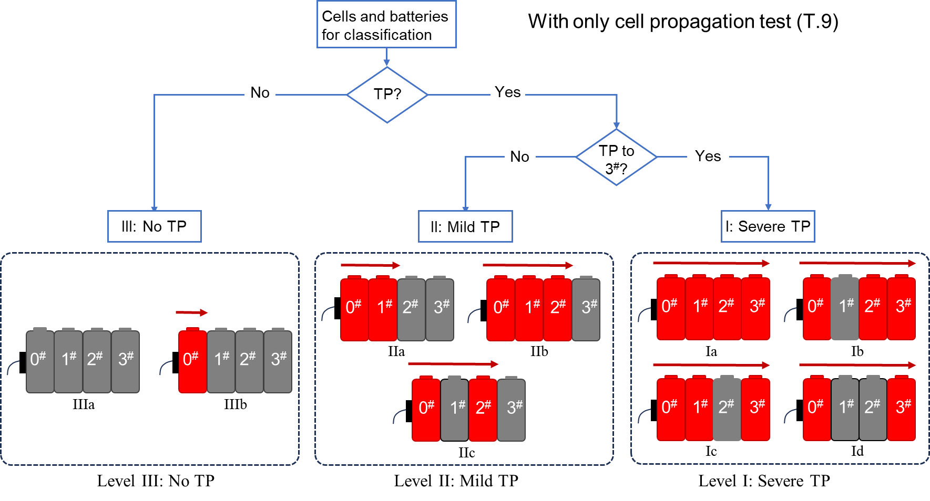
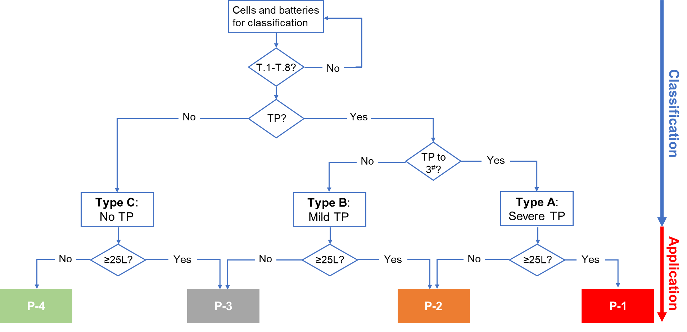
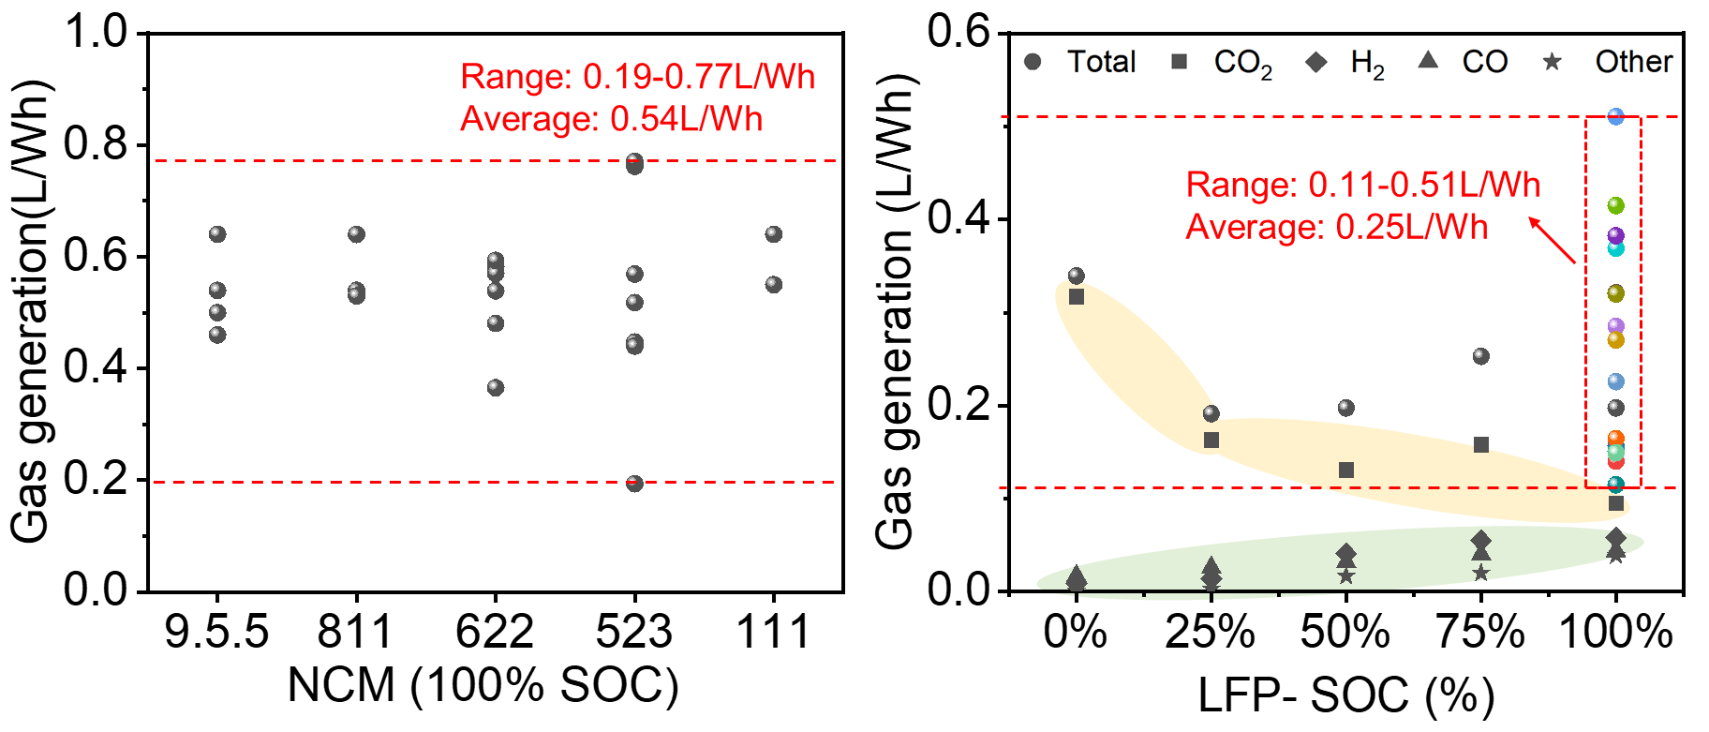
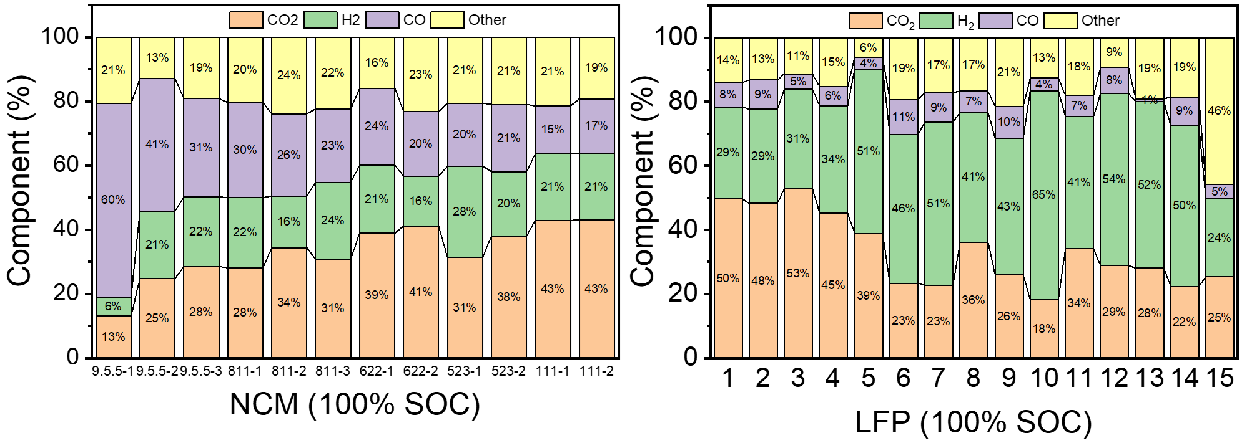
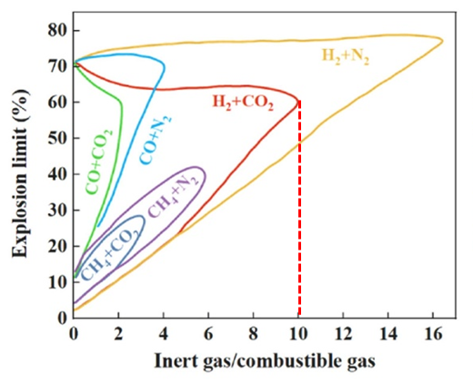
1. Classification Scheme
Many ideas and suggestions have been proposed by Chinese experts.
No more than 4 categories
Specific gas volume per unit-energy V_{E} （T.10/T.12）
The mixed gases from current Libs TR are definitely flammable (T.13)
ST/SG/AC.10/C.3/2025/57 Comments on the hazard-based system for classification of lithium batteries Transmitted by the experts from China, and IWG meetings.

Slide 4
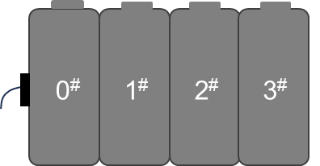
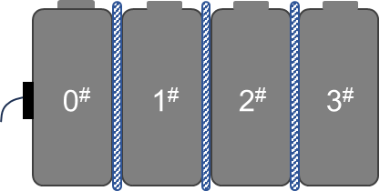
1. Classification Scheme
-About T.9-T.13 tests
An effective and feasible testing plan is the basis for hazard classification.
T.9: Cell propagation test
T.10: Cell gas volume
Actual test in sealed chamber;
Gas volume can be estimated via the empirical equation.
T.13: Cell, battery or equipment thermal runaway propagation prevention (equivalent air gap determination)
T.11: Battery propagation
One battery with a component cell triggered into TR;
Two battery(SCB/No casing);
Equivalent T.9 test.
T.12: Battery gas volume
V_{gas} (T.10) × N_{TR}(T.11)；
Actual test in sealed chamber;
Gas volume can be estimated via the empirical equation.
T.9/T.11 TP test with a certain airgap.

Slide 5
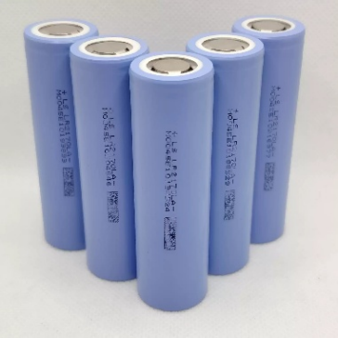
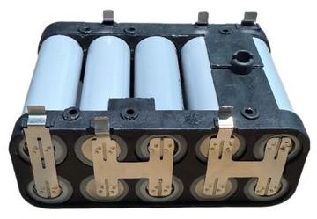

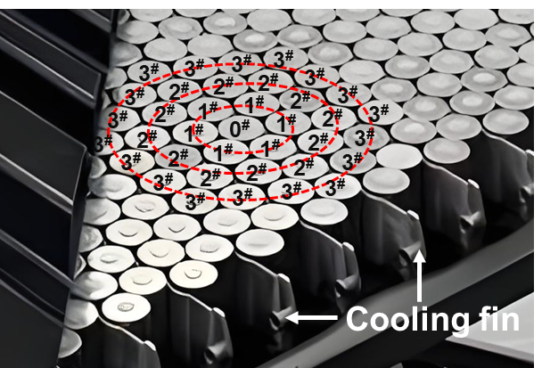
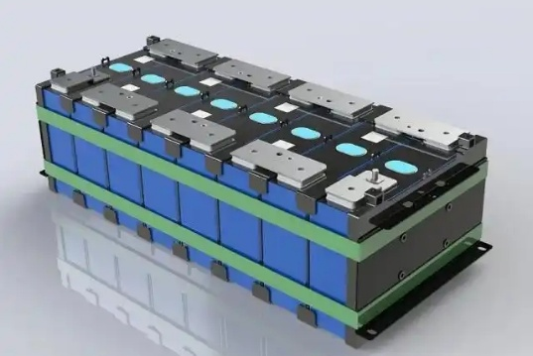
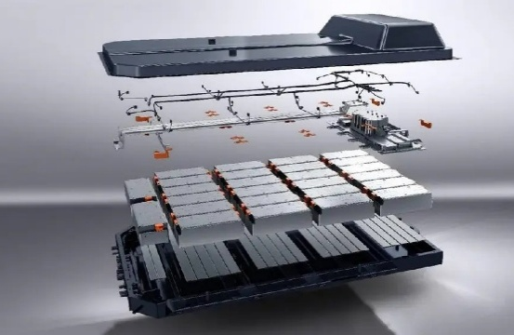
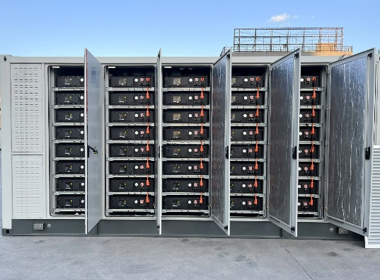

1. Classification Scheme
-About T.11 Battery TP test
Thermal propagation (TP)
Thermal runaway spread consecutively from one cell to nearby cell(s).
Note 1: Also known as thermal runaway propagation.
Note 2: Battery thermal propagation begins with the component cells thermal runaway or thermal propagation, which is also a kind of worst situation.
Cells
Small Module
Electric tool battery
EV Battery
or
or
Large Module
EV Battery
ESS

Slide 6
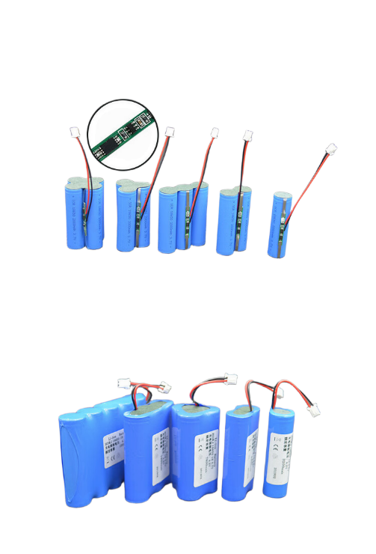
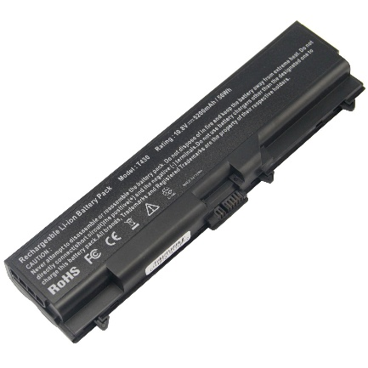
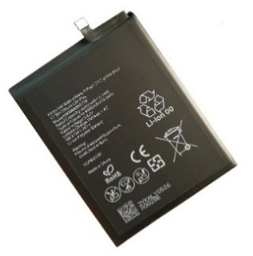
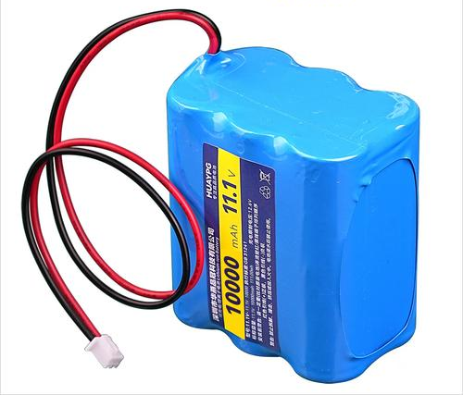
1. Classification Scheme
-About T.11a battery TP test
For relatively small battery without 4 cells in a row (figures below), the thermal propagation hazard could not be evaluated effectively as there is no target cell (3#).
Therefore, it is more appropriate to carry out the TP test using the 4 component cells in a row just like T.9, which is called T.11a (≈T.9).
SCB
4cells
3cells
3cells
2cells
SCB
6cells
PC Battery

Slide 7

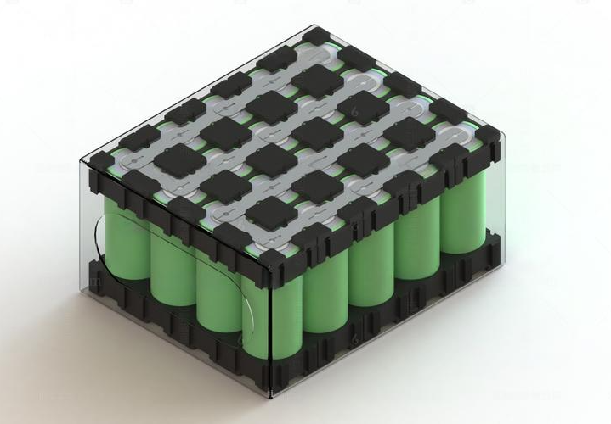

1. Classification Scheme
-About T.11b battery TP test
For relatively large battery composed by many cells (4 cells in a row, like figures below), the thermal runaway propagation (0#|1#|2#|3#) hazard evaluation model exist.
Therefore, it is appropriate to carry out the TP test using the actual battery product to verify the real TP hazard, which is named T.11b.
Note: If the battery for T.11b test could not be provided or of high value, 4 component cells TP test (≈T.9) is permitted.

Slide 8
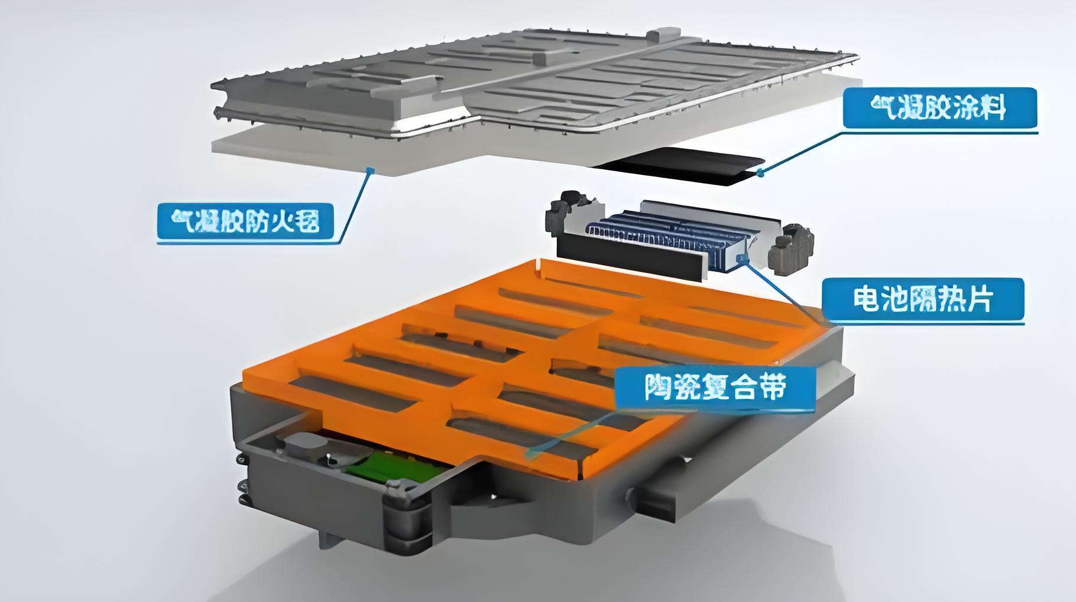
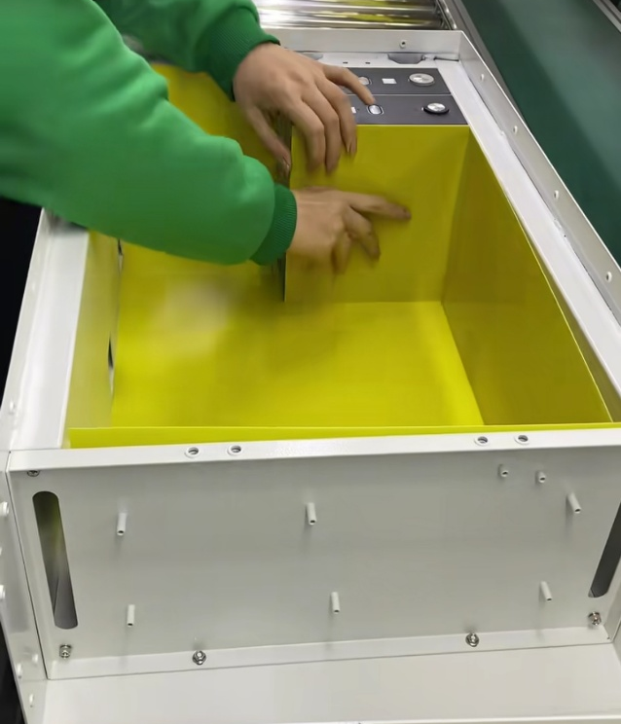
1. Classification Scheme
-About T.11 Battery TP test
In the actual battery products, there are scientific safety designs (figures below) to reduce thermal propagation risk, such as, BMS as well as flame-retardant materials like sheets, coating, plates, air gap, liquid cooling etc. So, in T.11b, TP test with actual battery product is necessary. Furthermore, the key focus of transportation regulations should be on packaging protection.
Air gap

Slide 9
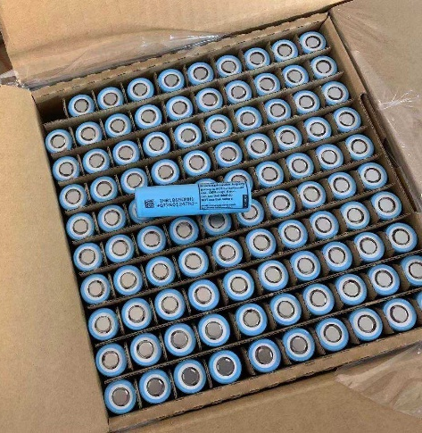
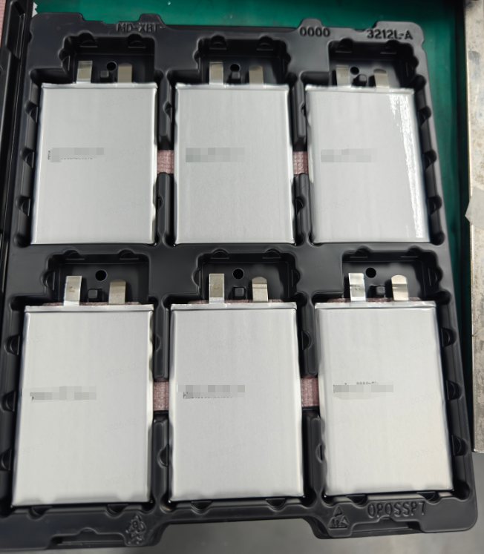


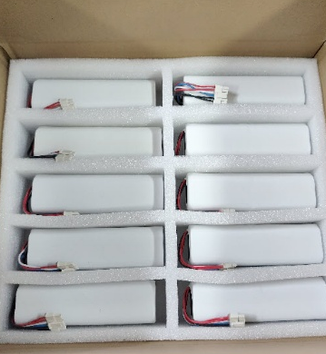
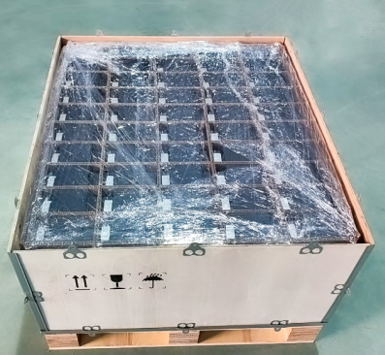
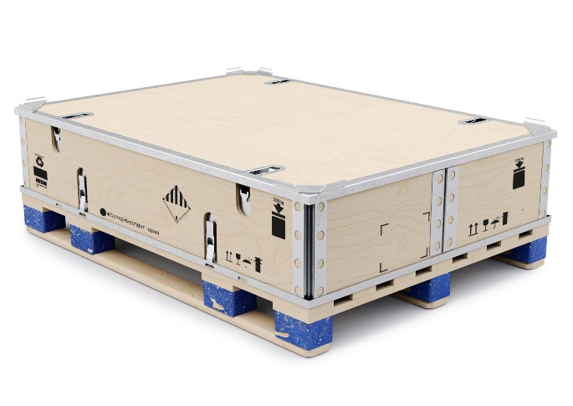
1. Classification Scheme
-About the flame retardance
Cylindrical Cell
Pouch Cell
Prismatic Cell
For actual transportation, some measures like tray/pad/separator plates/materials have already been used to prevent the battery from moving and keeping a certain distance with good mechanical performance.
For cells/batteries with TP hazard, the fire resistance performance of the inner/outer packaging materials should be requested in the new packaging instruction.
Battery
Battery
EV Battery

Slide 10
1. Classification Scheme
-About 0.25L gas threshold
0.25 liter of gas threshold:
This volume is related to general considerations of the maximum size of lithium cells existing on the market today. Typically, it was considered that large cells are around 1000 Wh, with a maximum size of about 1,25 liters.
So the small volume 0,25 liters was determined as 20% of the total cell volume and represents the maximum free volume of gas inside a cell, that can escape during a venting without thermal runaway.
[From UN/SCETDG/68/INF.13]
As known, the lithium cell is not completely filled with the cell core with approximately 5% ~ 10% empty space at standard conditions (25ºC & 0.1MPa).
Pressure relief valve threshold of cylindrical and prismatic Cell is about 1.1 MPa and 0.7 MPa.
So, even 20% gas is generated, the relief valve would not be open. At the same times, it’s hard for new cells under normal transport condition to produce so much internal gas, if true, it must be thermal runaway.
In a word, 0.25L gas threshold is not necessary.

Slide 11
Cells or batteries for classification
2. Classification Tree
No
T.1-T.8?
Not subject to other provisions
Dangerous goods
TR or
T＞150ºC
TP test?
（100%SOC）
TP test?
（30%SOC）
No TR & T≤150ºC
No TR & T≤150ºC
TR or
T＞150ºC
TP
No
V_{Gas}≥25L?
Yes
Type D
Type C
Type B
Type A
P-4
(SP188)
P-3
(P923)
P-2
(P922)
P-1
(P921)

Slide 12
3. Packaging Instruction
Type A means relatively high hazard of thermal propagation. So, it is necessary to appropriately enhance the packaging requirements, but they should not exceed the requirements in P911.
Type A
P-1
(P921)
Type B
P-2
(P922)
Being classified into Type B, C or D, new cells/batteries have very low hazard of TP and TR. Actually, most new ones would not show dangerous features during transportation situation. So, for these types, PI (P922、P923、SP188) are suggested to be as consistent as possible with current regulation (MR).
Type C
P-3
(P923)
Type D
P-4
(SP188)

Slide 13
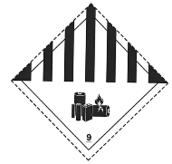

3. Packing Instruction
Type | Packing Instruction | Test items | Purpose | Packing Requirements | Label/Mark
A | P921 | TP preventing tests Stack test Drop test | No thermal runaway propagation No mechanical damage | Good mechanical performance The flame retardance ≥ V-1 (IEC 60695-11-10). Dangerous packing certificate | 9A label
B | P922 (≈P903) | Stack test Drop test | No mechanical damage | Good mechanical performance Dangerous goods (DG) packaging certificate | 9A label
C | P923 | Stack test Drop test | No mechanical damage | Good mechanical performance | 9A label Battery mark
D | SP188 | Drop test | No mechanical damage | Good mechanical performance | Battery mark

Slide 14

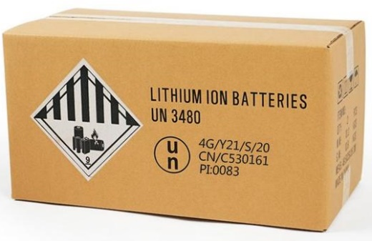
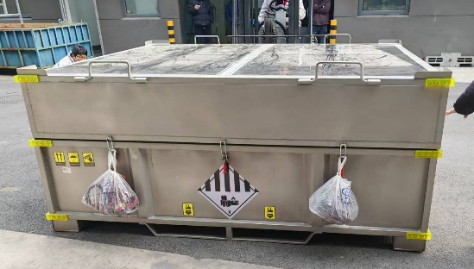
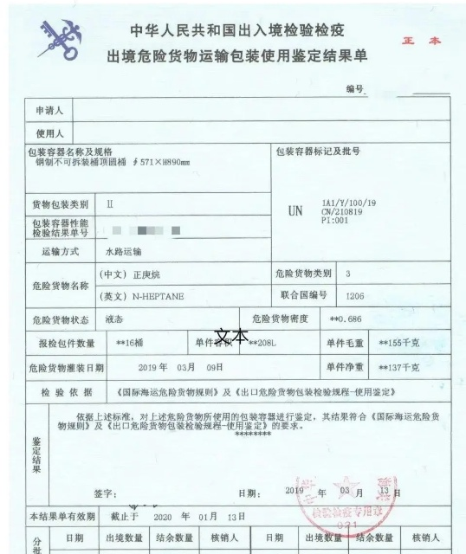
3. Packing Instruction
P923
P921
P911
vs
vs
Good mechanical performance;
Strong out packaging;
PG II performance level;
Strong out packaging;
DG packaging certificate;
The flame retardancy ≥ V-1;
PG I performance level;
Additional requirements verified by the competent authority.
T < 100°C, No flame, No projectiles;
Structure integrity maintain;
Gas management system;
etc.
DG packaging certificate is issued by the Chinese Customs authorities to certify that the DG packaging for complies with UN MR. It is a mandatory document for customs clearance and shipping bookings.

Slide 15

Thanks for your listening!
Ting Xu xt@ghs.cn
+86 158-0061-6132
Hong-Hui Wang whh@ghs.cn
+86 130-7213-9895

